Slide 1
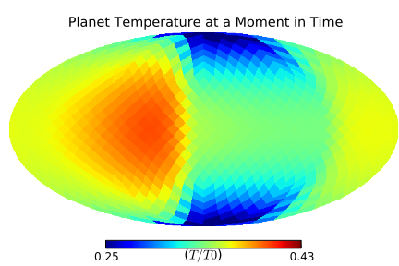
Thermal Phase Variations of Eccentric Hot Jupiters : an energy balance Model
SURA summer research project by: Diana Jovmir
Supervisor: Prof. Nick Cowan, MSI

Slide 2
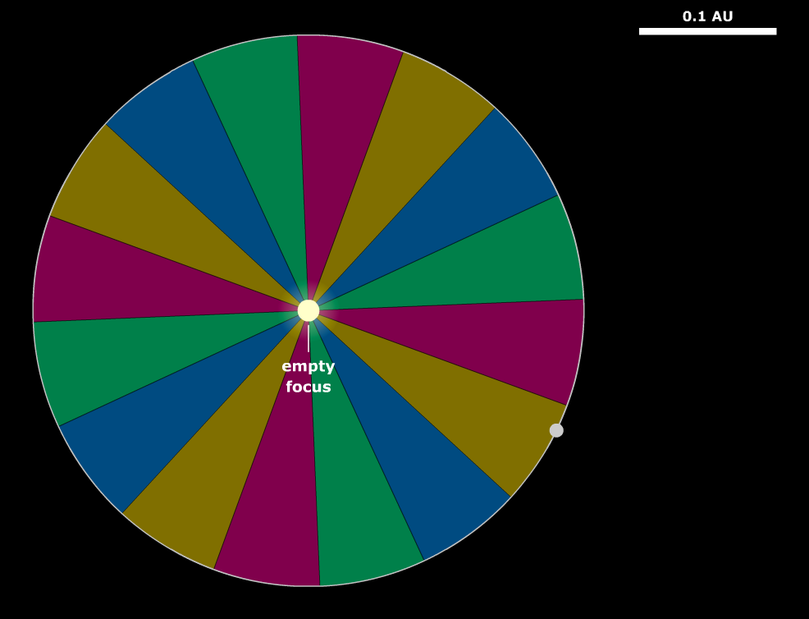
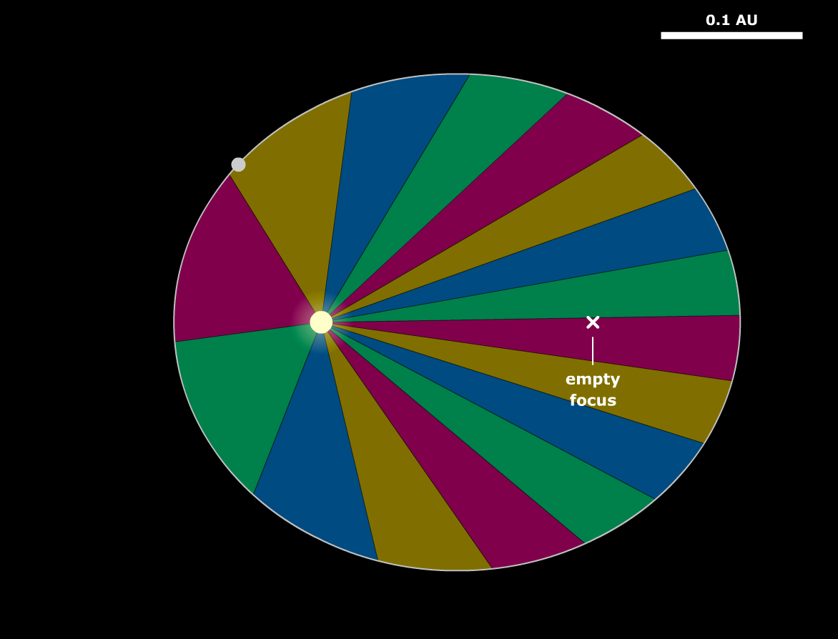
everything’s spinning!
Tidally Locked : The sun is stationary in the sky and planet receives uniform flux throughout the orbit.
Heat recirculation in the atmosphere will cause light curves to shift and lose amplitude.
Planet is only ‘tidally locked’ at periastron.
Radiative timescales, prevailing winds and variations in incident flux due to orbital position will interact to generate more complicated light curves.
astro.unl.edu/naap/pos/animations/kepler.swf [8]

Slide 3
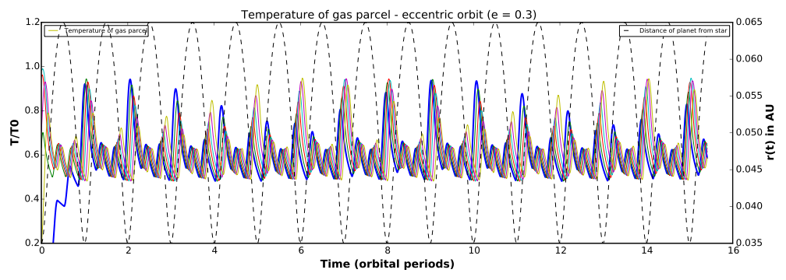
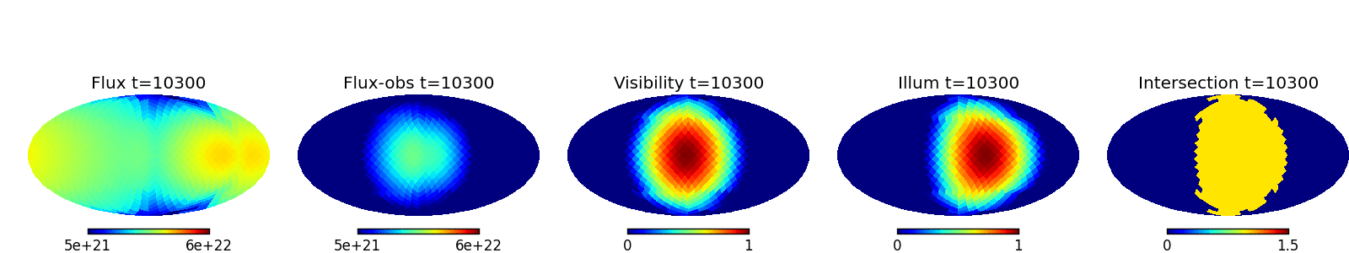
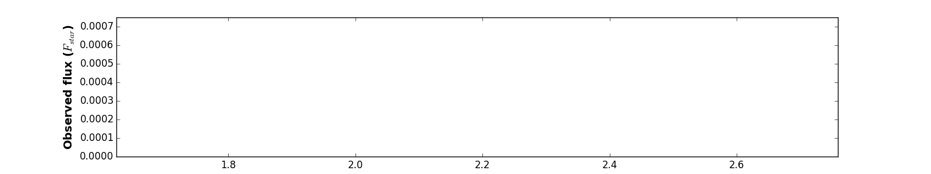
The model in pictures
Step 1: Solve differential equation for temperature as a function of time and position
Step 2: Flux maps and viewing geometry
Step 3: Calculate the light curve!

Slide 4
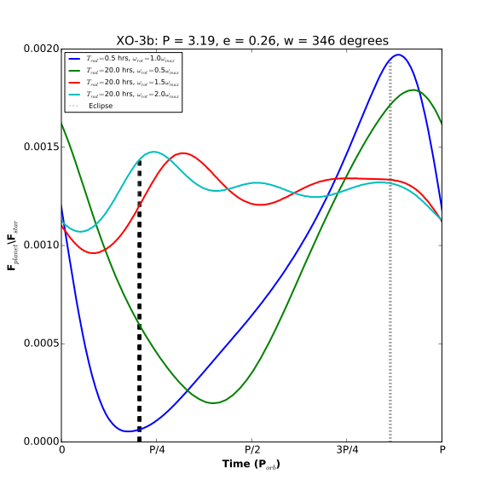
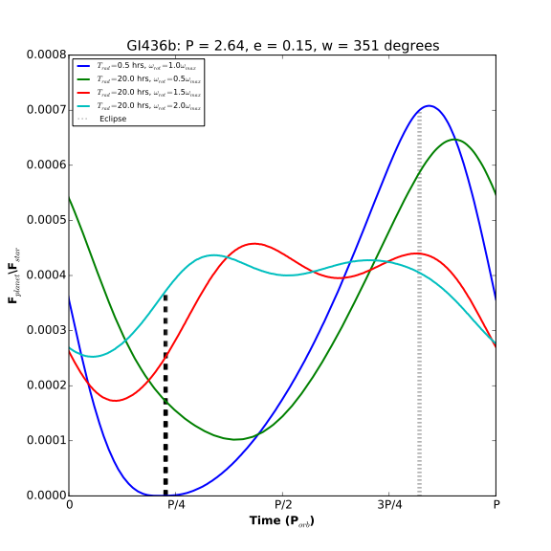
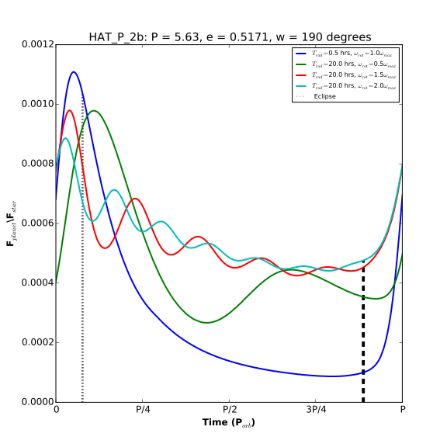
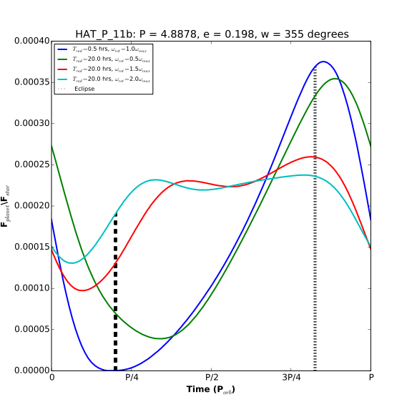
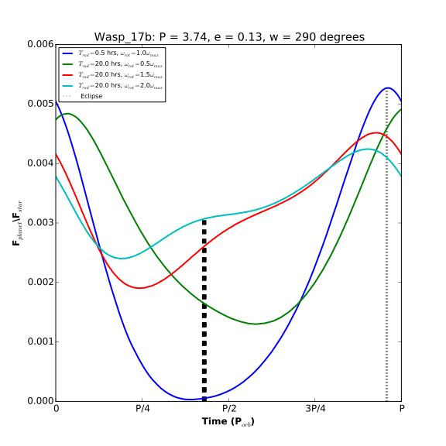
Example Light curves : Eccentric orbits
For eccentric planets, transits don't necessarily happen at a minimum in flux.
There can be ringing.
Takes a little less than 0.1 seconds to to generate a light curve.

Slide 5
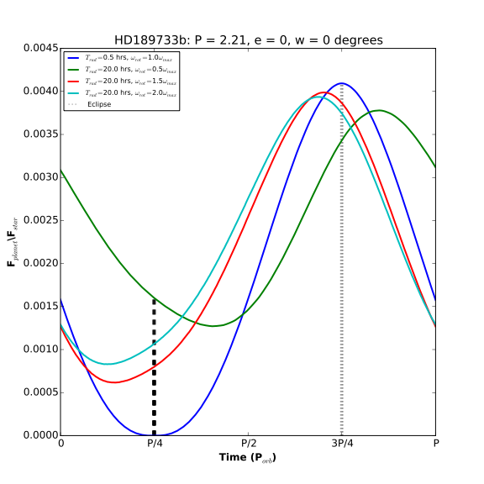
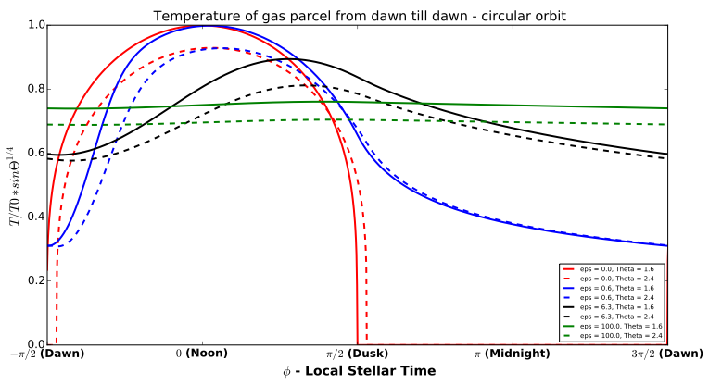
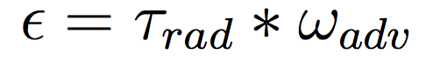
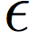
SPECIAL CASE: Circular Orbits
Depends only on circulation efficiency parameter:
The amplitude of temperature contrast and offset observed in the light curve can be related to each other (parametrically) through the circulation efficiency parameter .

Slide 6
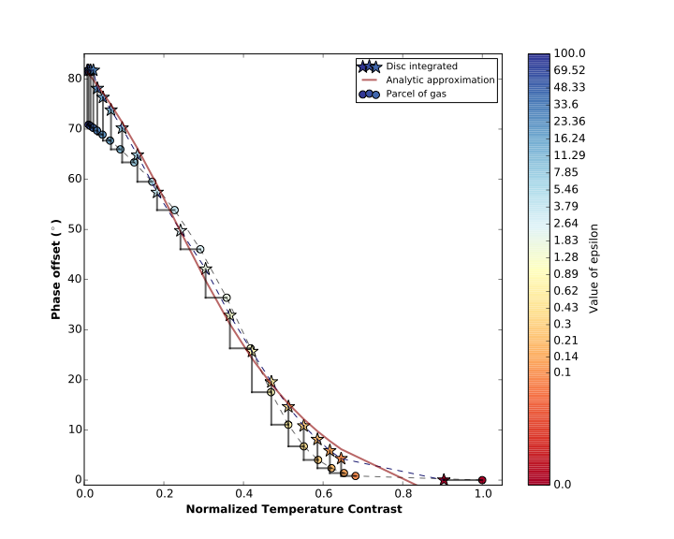
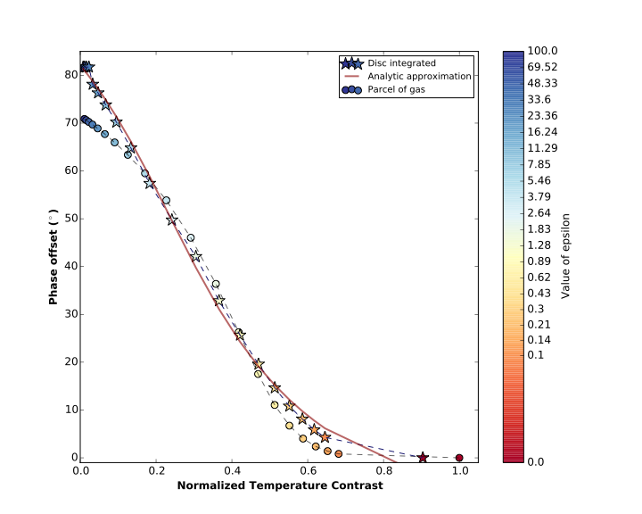
Application : Circular orbit
Prediction for FINESSE mission
FINESSE is a space telescope that will measure bolometric flux for many planets
We’ll get to see if this simple energy balance model would make a good approximation for phase curves once that data is available.
Disc integrated maximum happens later in the day (or earlier in the orbit) than the temperature maximum because of unevenness in heating/ cooling.
Amplitude of temperature variations decreases when disk integrating

Slide 7
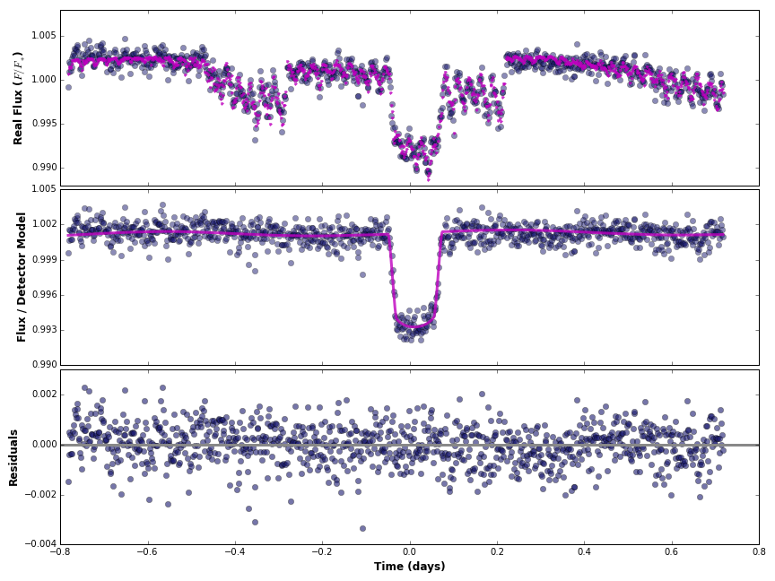
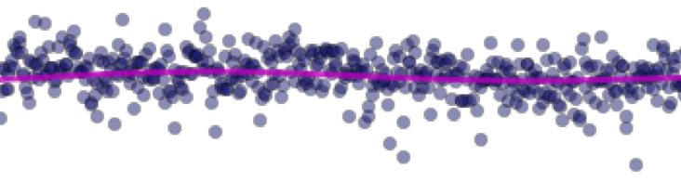
APPLICATION: Fitting
Tried to fit a light curve using batman [6] and emcee [ 5] this is what happened.
Inconclusive - theres no eclipse in this data, it would be helpful for constraining the amplitude of the flux variations.
How long did it take? about 1.5 hours per 1000 steps with 100 walkers.

Slide 8

What’s next??
Fitting phase curves worked so far but inconclusive. Would like to try it on data that contains an eclipse.
More detailed explanations about how the model works in Nick’s paper [1].
Code and examples on Github, you can use it or improve it if you’d like. https://github.com/dianaj/heatmap/tree/master
Code isn’t perfect, some of it is even very rushed. Testing takes a long time. Bugs and problems I noticed are mentioned in the docstrings to the files.
Contact me if you want to use this and you have questions: djovmir@gmail.com

Slide 9
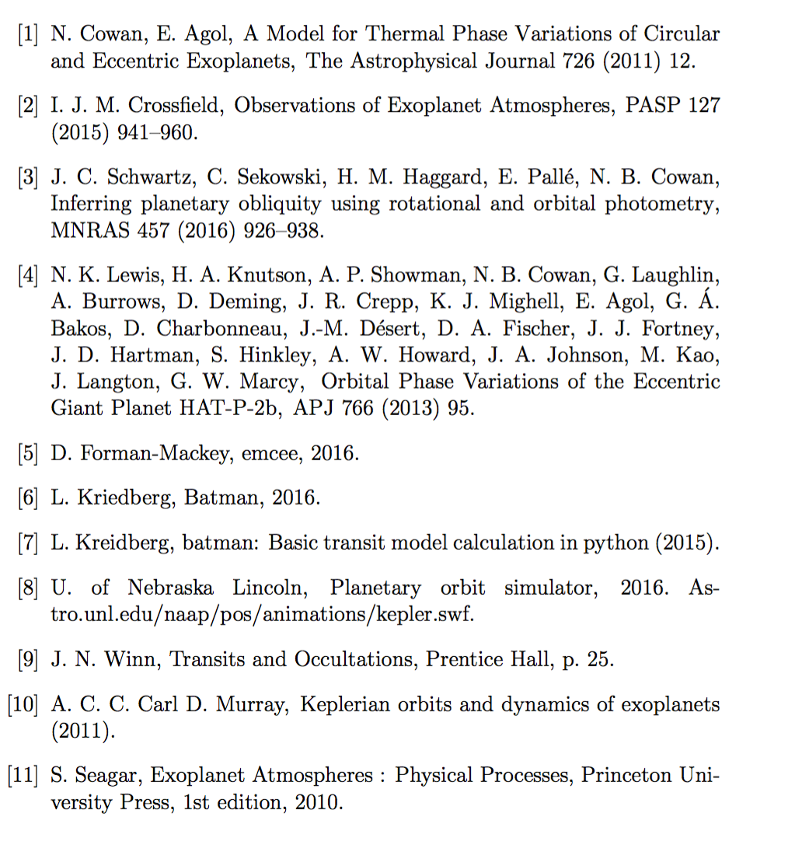
References

